Slide 1
AICON mini-seminar
NFVdeep: Adaptive Online Service Function Chain Deployment with Deep Reinforcement Learning
NFVdeep 1

Slide 2
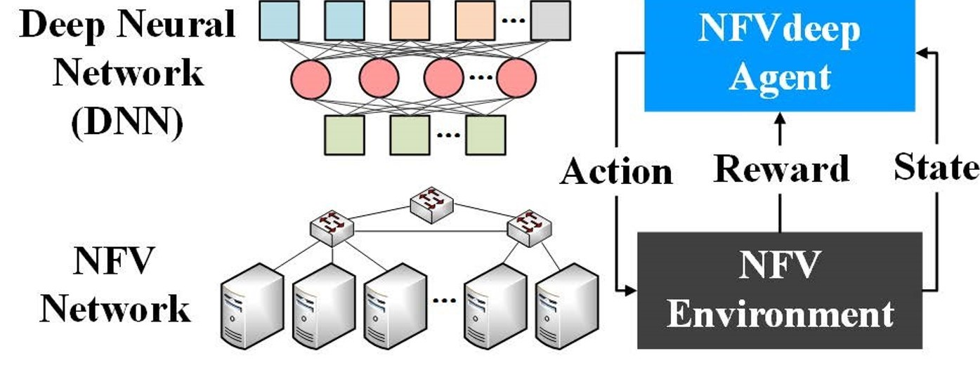
Shiftting the hardware implementation of middle boxes of the network to software
-NFVdeep network is formed of SCFs which consist of multiple of VNFs.
NFVdeep 1
NFVdeep 2

Slide 3
-SFCs are the requests received from the client
Continuous Real Time Requests with different QoS requirements.
Network State Transition.
-Problem: SFC deployment or VNF placement
NFVdeep 3

Slide 4
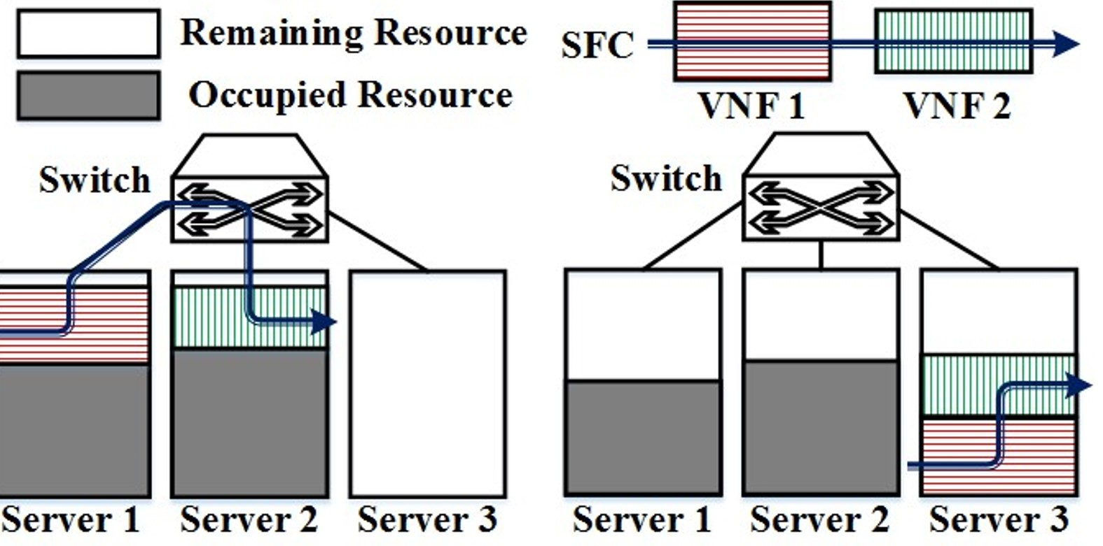
Different ways of SFC deployment a-shuts idle servers down b-make use of all resources.
NFVdeep 4

Slide 5
NFVdeep Architecture:
    NFVdeep 5

Slide 6
MDP Model:
Shows how to deal with Real time continuous arriving requests.
At each time slot
1-Remove timed out requests
2-indicate the network state
3-decision.
4-calcilating the new reward
Types of policies: a-Value based approach (used with DQN ) b-policy gradient (used with real time requests)
NFVdeep 6

Slide 7
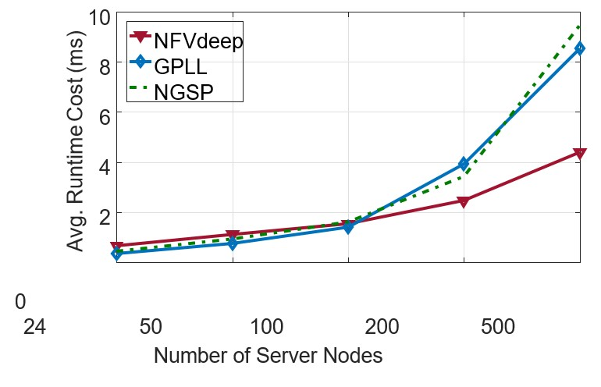
Comparison of NFVdeep performance with other systems
First graph: in terms of operation cost.
NFVdeep 7

Slide 8
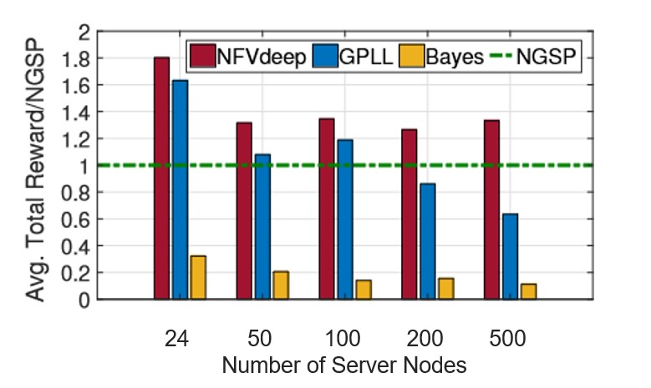
-Second graph: in terms of Total Reward.
NFVdeep 8

Slide 9
Thank You
NFVdeep 9

Slide 10
References:
Xiao et al.: "NFVdeep: Adaptive Online Service Function Chain Deployment with Deep Reinforcement Learning", IWQoS 2019
NFVdeep 10

